Slide 1





Coding Practices
Life with R

Slide 2

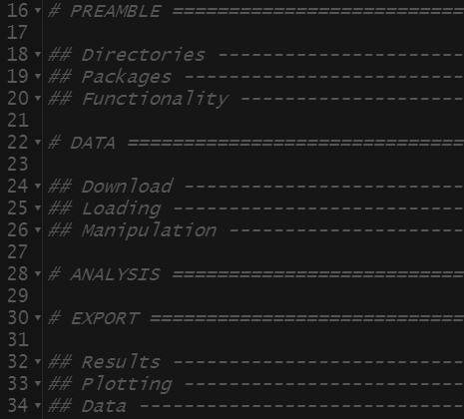
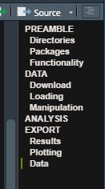
Code Structure
Preamble
rm(list=ls()
Directories
Packages
Sourcing
Data
Loading
Manipulation
Download
Analysis
Statistical Tests/Models
Header
Title
Contents
Author
Export
Results
Plots
Manipulated Data
Code Folding
Braced Regions (“{…}”)
Code Sections
Code Sections
Title followed by 4:
“#”
“=”
“-”
Section Hierarchy determined by preceding “#”
Requires Rstudio Version ≥ 1.4

Slide 3
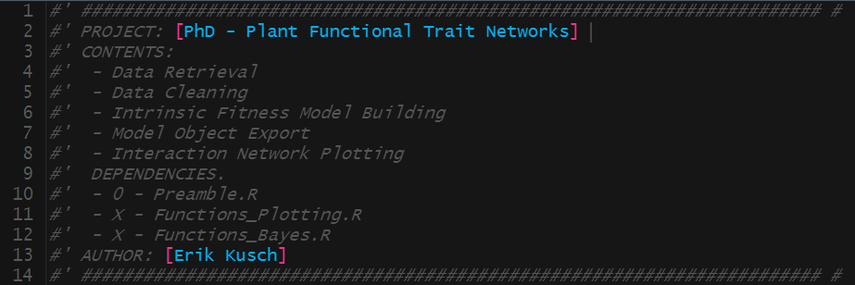
Header
Preamble
rm(list=ls()
Directories
Packages
Sourcing
Data
Loading
Manipulation
Download
Analysis
Statistical Tests/Models
Header
Title
Contents
Author
Export
Results
Plots
Manipulated Data
Information of:
Project Membership
Contents
Dependencies
Authorship
Can be used to track edit dates, but file versioning is better for this

Slide 4
Preamble
Preamble
rm(list=ls()
Directories
Packages
Sourcing
Data
Loading
Manipulation
Download
Analysis
Statistical Tests/Models
Header
Title
Contents
Author
Export
Results
Plots
Manipulated Data
rm(list=ls())
Clears working directory
Assures your code is self-contained
Directories
Avoid hard-coding directories
Use getwd() and file.path() for soft-coded directories
Packages
Do not use library() to load packages
Automatically install packages that are needed, but not installed
Sourcing/Functionality
Source other code documents
Create small helper functions

Slide 5
Data
Preamble
rm(list=ls()
Directories
Packages
Sourcing
Data
Loading
Manipulation
Download
Analysis
Statistical Tests/Models
Header
Title
Contents
Author
Export
Results
Plots
Manipulated Data
File Checks
Use file.exists(…) to check if data files are present
Download
httr::GET(…) for data download given a link
utils::unzip(…) for extraction of .zip archives
Loading
Do not load data via dialogue boxes!
Use code to load data
Manipulation
Do not manipulate data outside of R
→ Make all data manipulation traceable through R-Code

Slide 6
Analysis
Preamble
rm(list=ls()
Directories
Packages
Sourcing
Data
Loading
Manipulation
Download
Analysis
Statistical Tests/Models
Header
Title
Contents
Author
Export
Results
Plots
Manipulated Data
Data
No more manipulation of data
Subsetting is permissible
Analyses
Variable Selection
Analyses
Model Comparison
Model Evaluation
Naming
Do not override model objects
Use unique names for model objects/outputs

Slide 7
Export
Preamble
rm(list=ls()
Directories
Packages
Sourcing
Data
Loading
Manipulation
Download
Analysis
Statistical Tests/Models
Header
Title
Contents
Author
Export
Results
Plots
Manipulated Data
Results
Export model objects as .Rdata with save(…)
Export model summaries as .txt with sink(…) … sink()
Plotting
Export ggplot2 figures with ggsave(…)
Export base plot figures with png(…) … dev.off()
Manipulated Data
Do not override original data files!
Append suffix to data name (e.g. “_clean”)
Do not save as excel-readable files unless strictly necessary
Use saveRDS(…) to store .rds files

Slide 8
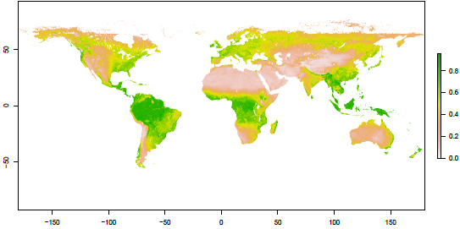
Naming Schemes
Specificity
What does the object contain?
Spaces
“_”for objects and “.” for functions
Capitalisation
Choose your style, but be consistent
Classes
Suffix/Prefix to indicate object class
Iterators
Avoid single-letter iterators
Logical Operators
Do not use “T” or “F”
 | Object | Function
Bad Name | mydata | fun
Specificity | NDVI1981 | Additionfunction
Spaces | NDVI_1981 | Addition.function
Capitalisation | NDVI_1981 | Addition.Function
Classes | NDVI1981_ras | FUN.Addition

Slide 9
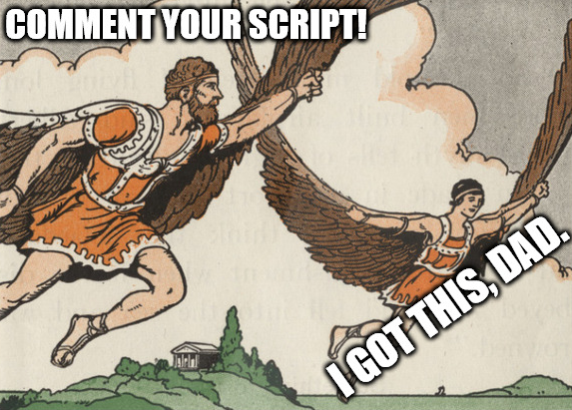

Comments
What?
Comments
Start with “#”
Are not executed as code
Why?
Convey goal of the code lines
Revisit code
How?
Good comments:
Specify (what the code is doing)
Justify (what is being done)
BAD!
GOOD!

Slide 10
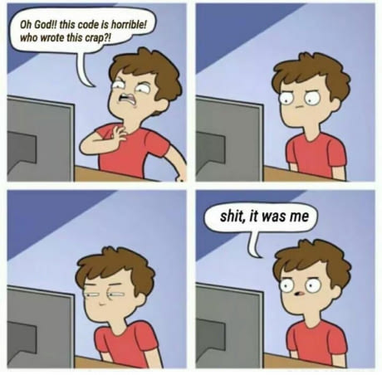

Quality of Life with R
Object Assignment
Use “<-” instead of “=“
Readability
Spaces in function specification
Line breaks between individual chunks of code
Soft-wrap in RStudio to prevent scrolling side-ways
Consistency
Develop a style and be consistent in using it

Slide 11
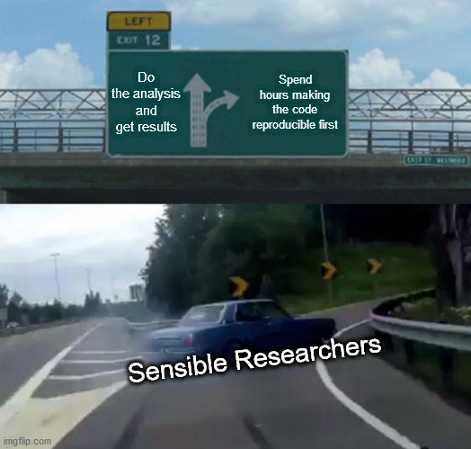
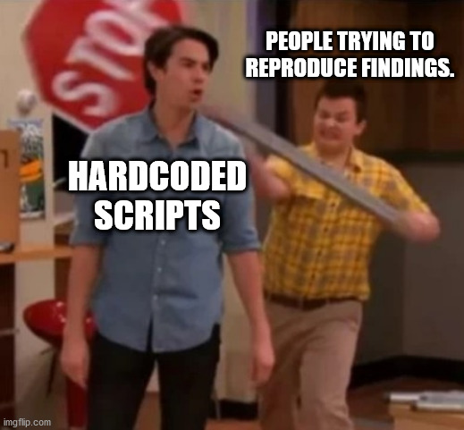
Reproducibility
Why Care?
Reproducible research as gold-standard of science
Journal Requirements
Code sharing
Data sharing
How?
STOP. HARDCODING.
Test your scripts on different machines.

Slide 12
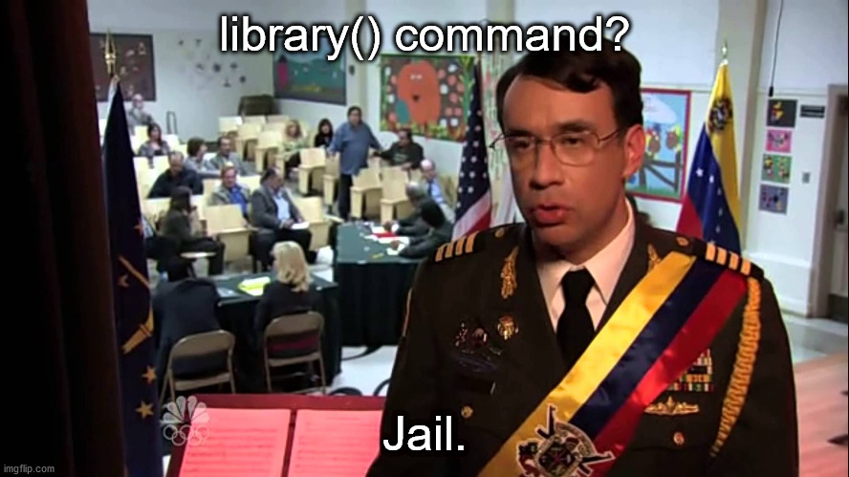

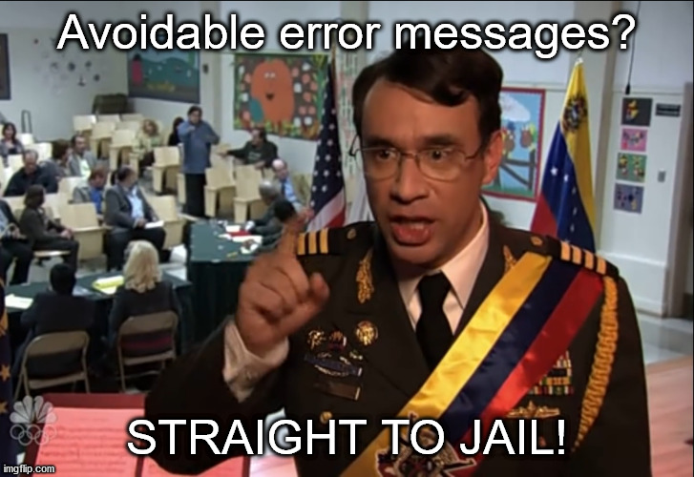
Reproducibility – Cardinal Sins

Slide 13
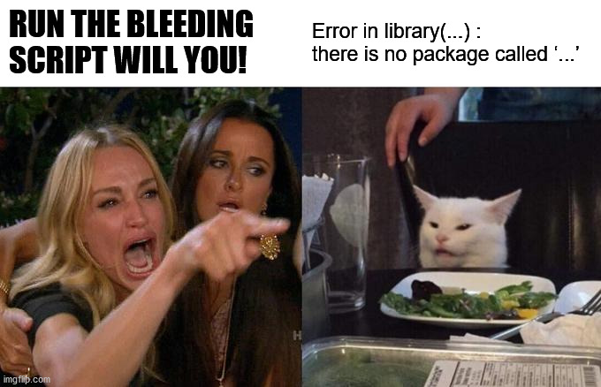
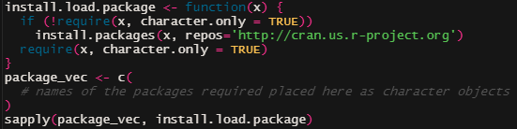
Packages
What People Do
Use library(…) to load packages
Not everyone has the same packages installed
Force installation via install.packages(…)
May disrupt local package versions
How To Do Better
Identify packages that need installing and only install those prior to loading

Slide 14
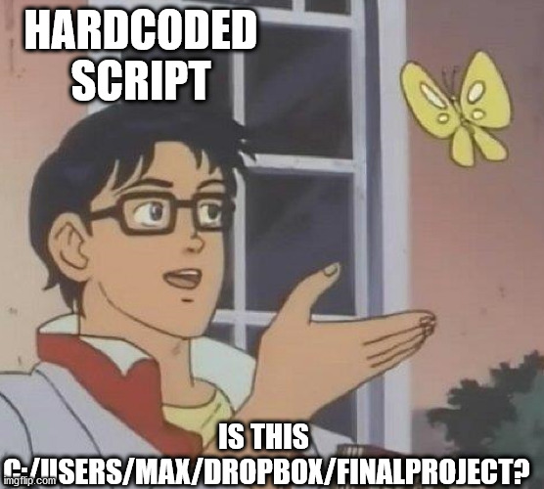

Directories
What People Do
Hardcode working directories with setwd(…)
→ Others do not have access to your hard drive
How To Do Better
Organise projects in separate folders
Softcode working directories:
getwd(…) to index project folder
file.path(…) to index sub-directories
Project Folder
Data
Exports
Raw
Manipulated
Plots
Models

Slide 15
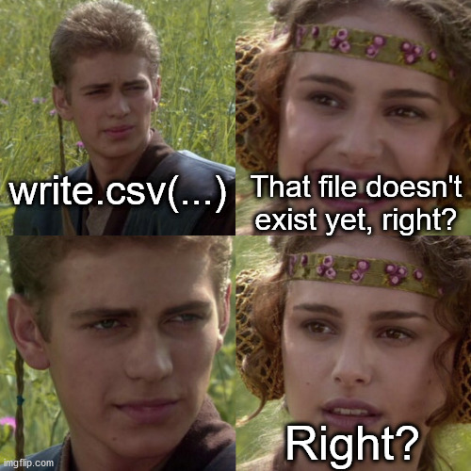
File Checks
What People Do
Overwrite existing data files
Can possibly break reproducibility and cement errors
Carry out analyses whose output is already present
→ Waste of processing time and power
How To Do Better
Check whether files are present with file.exists(…)
Load/Manipulate
Load/Write
Load/Analyse

Slide 16
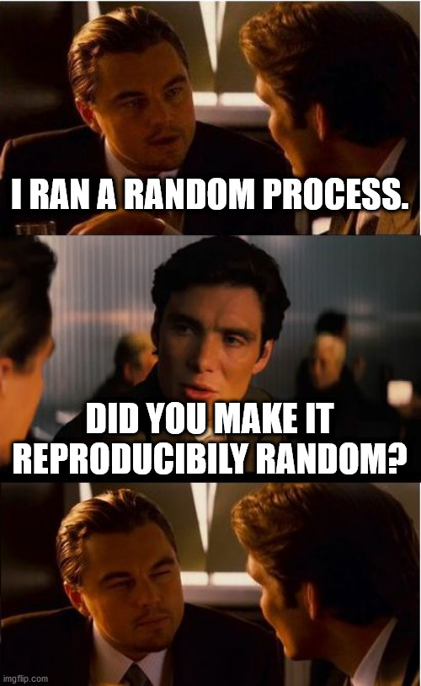
Random Processes
What People Do
Sample data sets
Partition data into test and training data sets
May induce severe bias
How To Do Better
Set a seed to make random processes reproducible
set.seed(…)
Sample multiple times and average out to remove bias
Bootstrapping

Slide 17
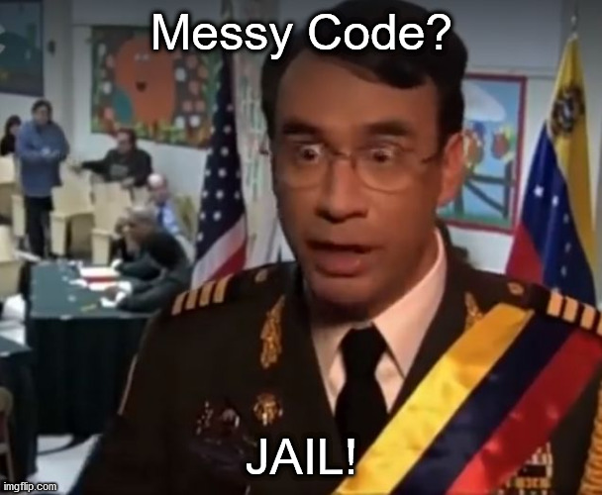
Reproducibility - Reporting
Code is as essential as your written report.

Slide 18
Reporting Code
Using Rmarkdown for your research comes with a multitude of advantages:
Entire workflow in one program (RStudio)
Research and reports reproducible at the click of one button
Combines R functionality and LATEX formatting (if desired)
Consistent formatting
Clear presentation of code
Dynamic documents (you can generate various output document types)
Applicable for almost all document types you may desire as an output

Slide 19

More Quality of Life Improvements
Everything hereafter is nice-to-have or nice-to-do, but not essential.

Slide 20
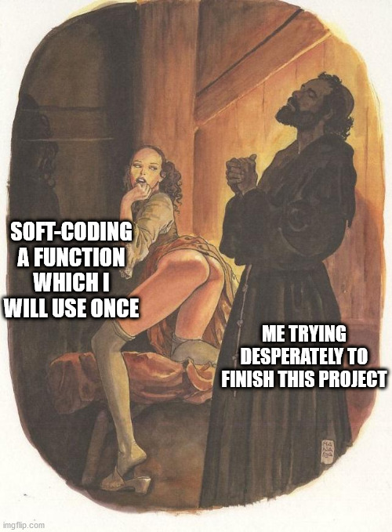
Functions & Sourcing
Big projects lend themselves well to a multi-document workflow:
Functions
Fun <- function(…){} to create a custom function
Useful for:
Soft-coding analyses
Repeating code for different input parameters
Should be:
internally consistent
well-documented
easy to understand
Sourcing
Source(…) command to load/execute R scripts
Useful for:
Keeping code structured and concise
Storing extra functionality
Should:
Use sensible file names
Sourced functions need to be called

Slide 21
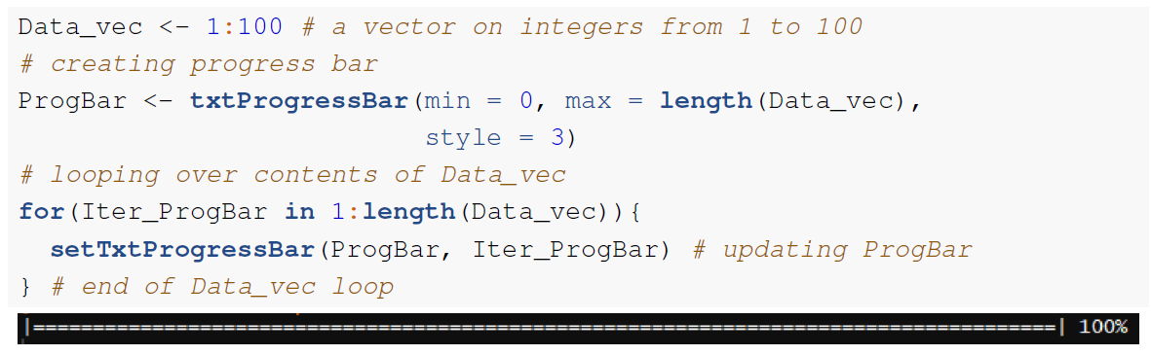
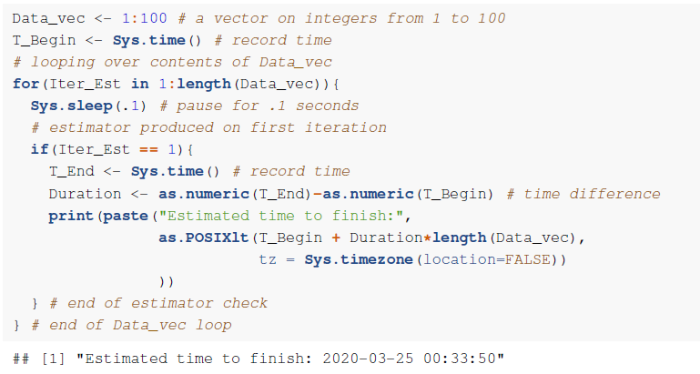
Progress Bar & Estimators
Progress Bar
Updates on how code is progressing
Especially useful when your code involves loops
Estimators
When to expect code to finish processing
Most useful in loop-based approaches as they need a baseline for the estimation

Slide 22

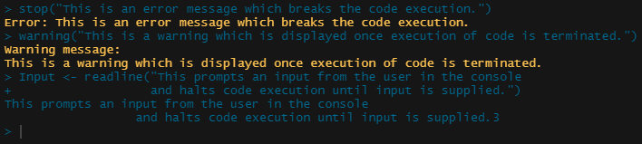

Errors, Warnings & User-Inputs
Errors
Stop code execution
Report message to console
Warnings
Do not stop code execution
Report message to console
User-Input
Pause code execution
Wait for user-input in console

Slide 23
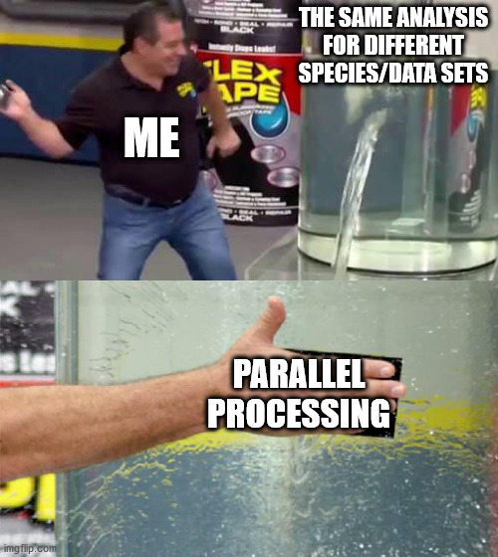
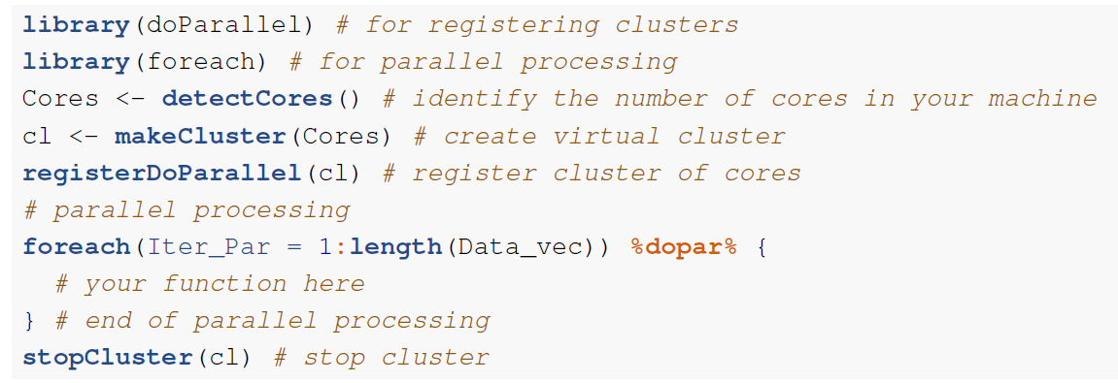
Parallel Processing
By default, R only uses one core
Inefficient use of computational power
Use parallel processing to make use of remaining cores
→ Particularly powerful when paired with eval(parse(text=“…”))

Slide 24
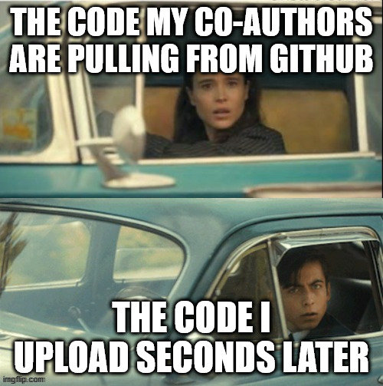
Versioning
Use GitHub to:
Track code and development
You may revert to previous versions of code if you broke something
Share code with others
You can make available R functionality and packages on GitHub
Collaborate with others
Pull requests and the issue feature allow for collaborative code development

